Slide 1


Conceptual Design Review
O.S.C.E.O.L.A.
Onboard Surveillance Camera Equipped Operational Lightweight Aircraft
Senior Design Team# 14

Slide 2
Team Members
Antwon Blackmon, ME
Walker Carr, ME
Alek Hoffman, EE
Ryan Jantzen, ME
Eric Prast, EE
Brian Roney, CpE

Slide 3
Introduction
Primary Objectives:
Systems Engineering approach for the design and manufacture of an Unmanned Aerial System (UAS)
System must be designed for:
  Waypoint Navigation
  Autonomous Area Search for Ground Targets
  Image Recognition of Ground Targets
System must comply with the 2012 AUVSI Student UAS Competition requirements.

Slide 4
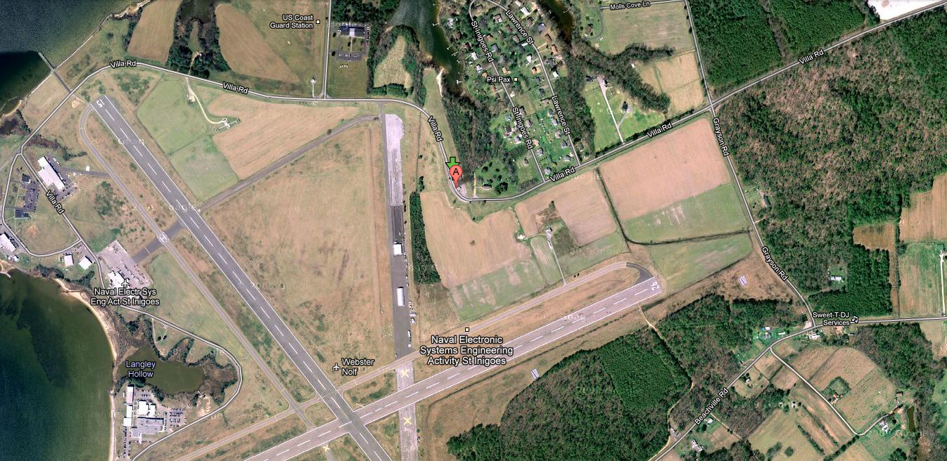
Waypoint Navigation

Slide 5
Autonomous Area Search

Slide 6

Image Recognition

Slide 7
Introduction
To accomplish our primary objectives, our UAS must be comprised of several subsystems:
  Aircraft Subsystem
  Avionics Subsystem
  Imagery Subsystem
  Ground Station Control (GSC) Subsystem

Slide 8
Aircraft Design Requirements
Positive or neutral stability on all axes
< 55 lbs.
40-60 minute flight time
Cargo bay for payload
Capable of slow, stable flight
Fast cruising speed
Easy to maintain
Portable

Slide 9
Planform Configuration
Desired Characteristics:
  Large volume for payload accommodation.
  Stable and Controllable
  High Aerodynamic Efficiency
  Maneuverable
  Transportable
  Ease of manufacturing

Slide 10
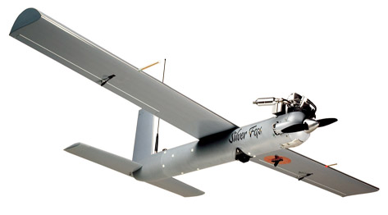
Planform Configuration
Concept 1: Conventional
  Conventional configuration with fuselage, wings and empennage
  Pros: Simple and stable
  Cons: Ordinary, extra fuselage space, large wetted area.

Slide 11
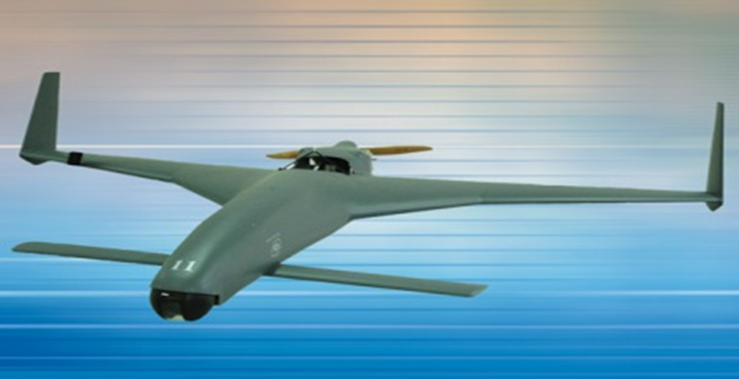
Planform Configuration
Concept 2: Canard
  Configuration with control surfaces towards the front of the aircraft.
  Pros: Easy to construct, good maneuverability
  Cons: Poor stability, complex control surface analysis

Slide 12
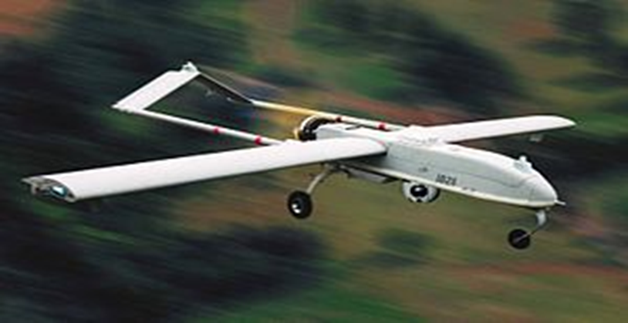
Planform Configuration
Concept 3: Twin Boom
  Twin booms extending from the wing to the aft empennage.
  Pros: Integrates with payload, easy to manufacture, transportable.
  Cons: Heavy, difficult to balance, limits tail configuration.

Slide 13
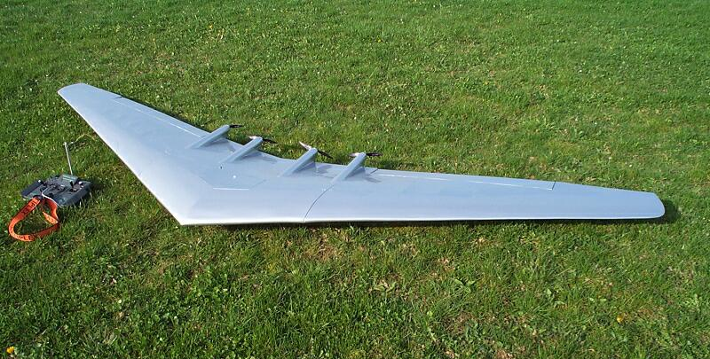
Planform Configuration
Concept 4: Flying Wing
  Configuration with no aft empennage.
  Pros: Fuselage contributes as a lifting body.
  Cons: Poor stability and maneuverability, complex dynamics.

Slide 14
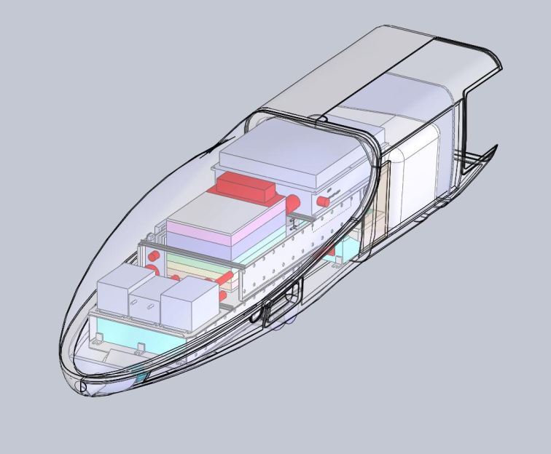
Fuselage Configuration
Primary Function:
  Payload accommodations
Major Areas of Influence:
  UAV performance
  Longitudinal Stability
  Lateral Stability
Configuration Alternatives:
  Geometry: lofting, cross section
  Internal Arrangement

Slide 15
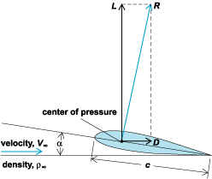
Wing Configuration
Primary Function:
  Generation of Lift
Major Areas of Influence:
  UAV Performance
  Lateral Stability
Configuration Alternatives:
  Type: Swept, Tapered, Dihedral
  Location: Low-wing, Mid-wing, High-Wing
  High-lift Device: Flaps, Slot, Slat
  Attachment: Cantilever, Strut-Braced
  Airfoil Geometry
  Wing Loading

Slide 16
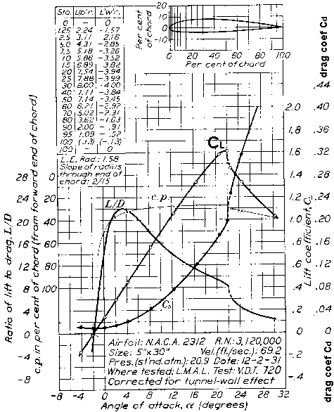
Airfoil Selection
Low Reynolds number (500,000-1,000,000) airfoils will be studied for our design.
Optimal Characteristics:
  Max. Aerodynamic Efficiency
  High Lift
  Low Drag
  Low Stall Speed
  High Cruise Speed

Slide 17
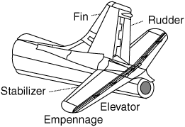
Empennage Configuration
Horizontal Tail:
Primary Function:
  Longitudinal Stability
Major Areas of Influence:
  Longitudinal Trim and Control
Vertical Tail:
Primary Function:
  Directional Stability
Major Areas of Influence:
  Directional Trim and Control

Slide 18
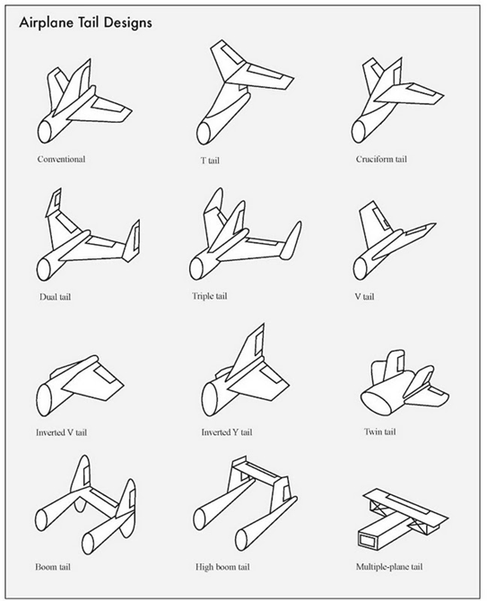
Empennage Configuration Examples

Slide 19
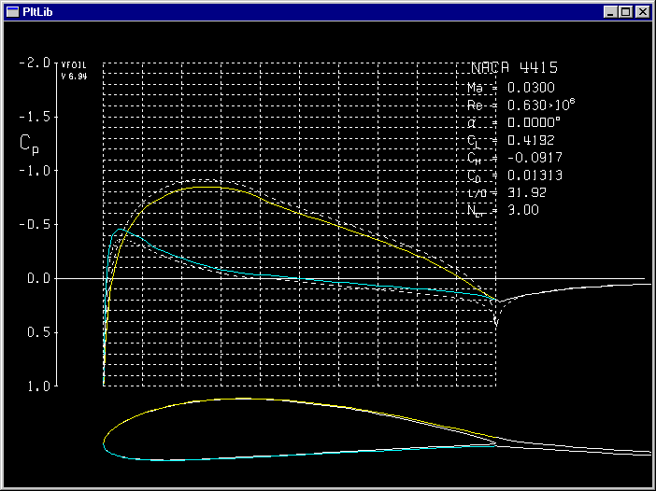
Analysis Methods for Optimal Design
Use XFOIL to calculate the pressure distribution on 2D airfoils to determine lift and drag characteristics.

Slide 20
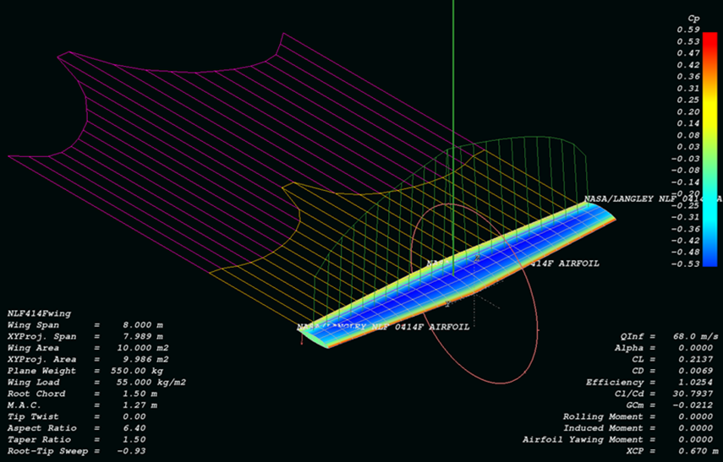
Analysis Methods for Optimal Design
Use XFLR5 to determine the lift and drag characteristics for the both the 3-D wing and empennage.

Slide 21
Analysis Methods for Optimal Design
Use the Aerospace toolkit in Matlab to simulate the flight of our aircraft in Flightgear.

Slide 22
Material Selection
The most important material properties to be considered are :
  Density
    Weight must be minimized to increase lift capacity
    Lower weight means more air time
  Strength
    The wings will be under both tension and compression
  Toughness
    It is critical that no part of the airframe is subject to failure
The best approach is to use different materials in different areas according to their properties

Slide 23
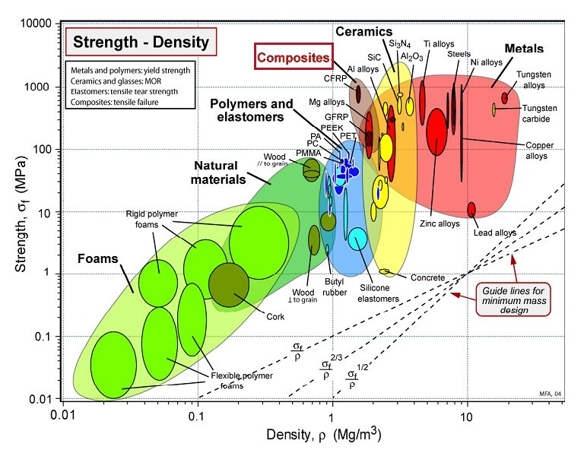
Material Selection

Slide 24
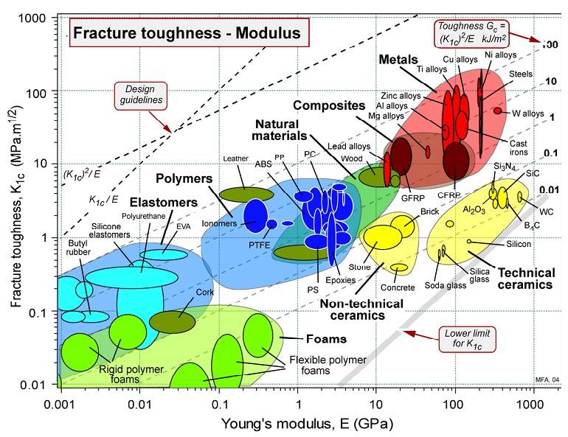
Material Selection

Slide 25
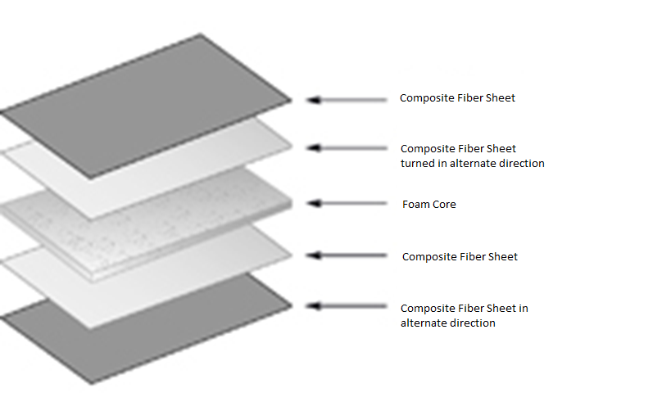
Fabrication Method
Composite sheets are layered atop of the mold (or core in the case of the wing) in alternating directions.
An epoxy resin is applied to each layer of skin till it is saturated.
This is coated in no ply sheeting and placed inside of a vacuum bag.
The resin is left to harden for at least 6 to 9 hours depending on the type used.

Slide 26
Selected Materials
Fiberglass
  A cloth woven of fibers of thinly extruded glass. Weight and strength varies with weave style and thickness.
Polystyrene blue foam
  A foam commonly used in RC flying wings and insulation. It has a compressive strength of 25 psi and a density of 1.9 lb/ft³.
Spyder foam
  A foam that has a vertical cell structure that provides a compressive strength of 60 psi and density of 2.3 lb/ft³
Carbon fiber
  features a higher tensile strength and toughness than fiberglass for similar a similar density.

Slide 27
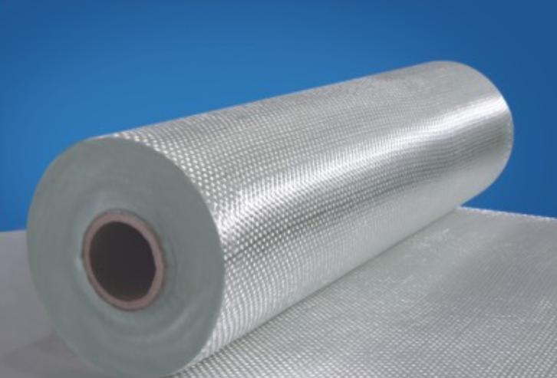


Materials
Carbon Fiber
Fiberglass
Spyder Foam

Slide 28
Concepts
Fiberglass Skin and Blue Foam Core
  Combination of lowest weight and least strength
Fiberglass Skin and Spyder Foam Core
  Increased compressive strength
  Reduction in spar size
Carbon Fiber Skin and Blue Foam Core
  Higher strength with less material
Carbon Fiber Skin and Spyder Foam Core
  Highest possible strength with lowest material
Hybrid composite skin
  Combination of fiberglass and carbon fiber

Slide 29

Concept 5:
Hybrid Composite Skin
Carbon fiber forms the outer layer with its high fracture toughness
Used to reinforce key sections of the plane including the nose, payload area, and wings.

Slide 30
Types of Motors
Electric Powered
  Clean, easier to start, light as possible
Glow/Gas Engines
  High energy/weight ratio
  Noisy
Propellers

Slide 31
Electric Powered
Brushed Motors:
Have brushes that carry current and spin the rotor.
Less expensive
Needs more maintenance
Less efficient
Brushless Motors:
A speed control energizes an electro-magnetic field causing the motor to turn
More expensive
Needs less maintenance
More efficient

Slide 32
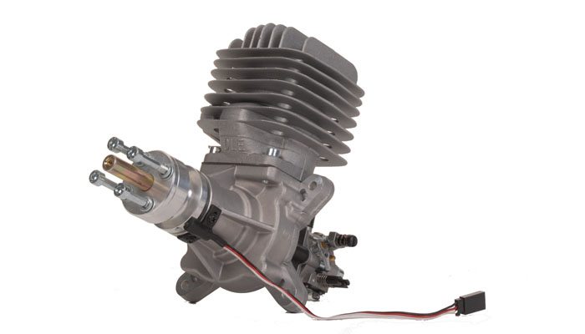
Glow/Gas Engines
Internal combustion engines.
Glow engines can not be operated with “gas”
Doesn’t use spark plug
2 stroke engines
  Fires with every revolution
  Easier to operate than 4 stroke
4 stroke engines
  Fires with every 2 revolution
  More maintenance
http://www.nitroplanes.com/dle55gaen.html

Slide 33
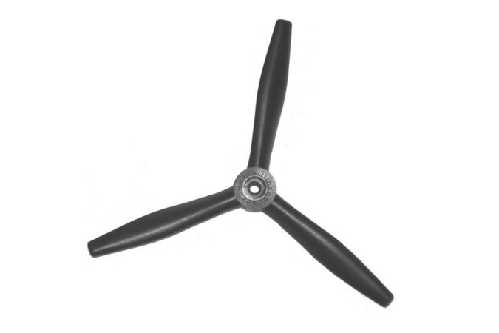
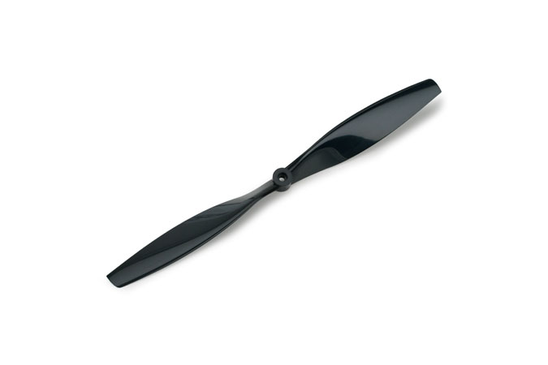
Propellers
Help move plane forward
Increase thrust
Single blade two-blade propeller

Slide 34
Power Supply System Concept Generation
Power supply system components and requirements:
  Electrical Storage Device
  Voltage Regulator
  Recharging Device
  The requirements for these basic components are drawn from attributes that are universally beneficial for an aircraft’s composition.
  Low weight
  Small size
  Low heat emission
  Ability to store and deliver the required electrical energy necessary for flight.

Slide 35
Power Supply System Concept Generation
Close relationship with the propulsion system of the aircraft.
  The propulsion plant of the aircraft could be powered either by gasoline or by electricity.
  Power supply system will either:
  Supply propulsion plant and other electrical aircraft components.
  or
  Supply only the aircraft’s electrical components and not the propulsion plant.

Slide 36
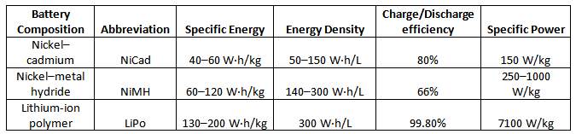
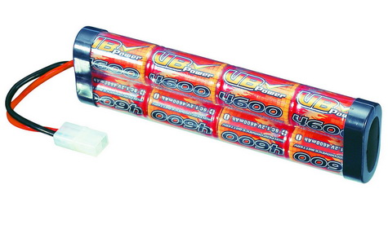
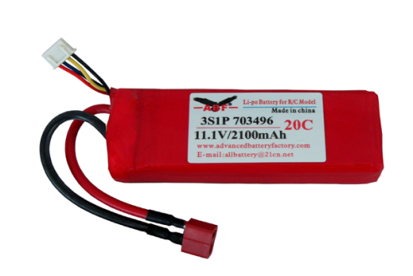
Power Supply System Concept Generation
Electrical Storage device (Battery)
  Most important part of power supply system.
  Types of batteries and their characteristics:

Slide 37
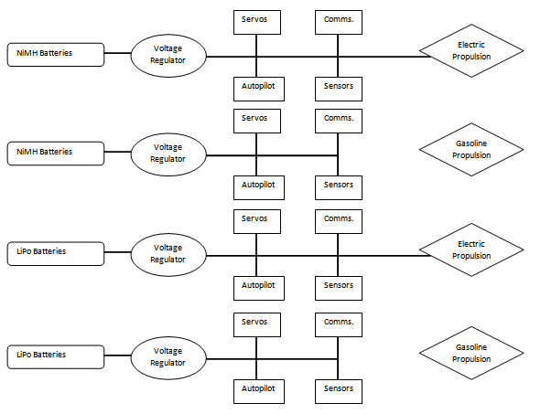
NiMH Battery Concept

Slide 38
LiPo Battery Concept

Slide 39
Autopilot System Concept Generation
Autopilot system requirements:
  Source code that is easy to modify to be able to implement search area algorithm
  Low power usage
  Easy interface with most sensors
  Way to control Camera System gimbal

Slide 40
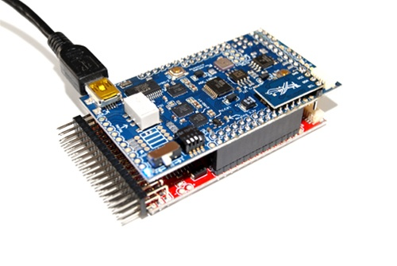
Autopilot System Concept Generation
Option 1: Ardupilot Mega autopilot
Ideal battery: 7.4V 2s pack with peak 1A
  Has built in power supply for 5V output lines
Weight: 45g, dimensions: 40mm x 69 mm
Pros
  Built in kill switch
  Program runs in windows
Cons
  Lacks extra ports for camera gimbal
  No source code is given

Slide 41
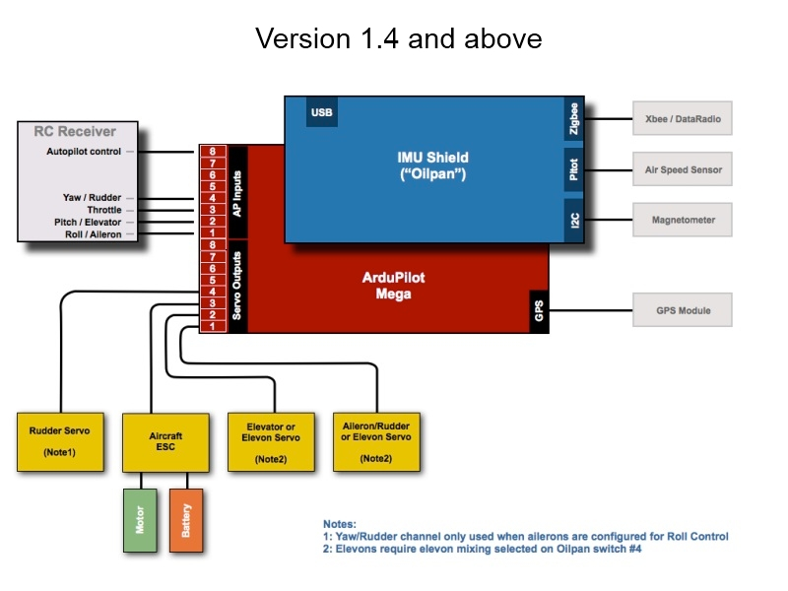
Autopilot System Concept Generation
Option 1: Ardupilot Mega autopilot

Slide 42
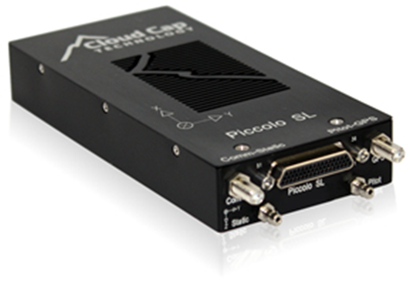
Power Supply System Concept Generation
Option 2: Piccolo SL autopilot board
5-30 Volt input, Power usage: 4W
Weight: 100g, dimensions: 130 x 59 x 19 mm
Pros
  Can run at 100°+ F
  10+ basic I/O lines
Cons
  The developer kit is sold separate
  The source code is made to not be modified
  Advanced features sold separately
    i.e. autolanding

Slide 43
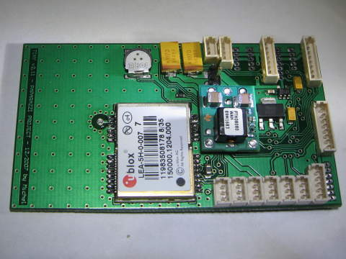
Autopilot System Concept Generation
Option 3: Paparazzi Tiny v2.11 autopilot
Battery: 5-18V, 2.5A max
  Has built in power supply for 5V lines
Weight: 24g (with GPS on), dimensions: 70.8 mm x 40 mm
Pros
  Built in kill switch
  Has extra ports for camera gimbal
  Source code downloadable and can be modified
  Interfaces with most sensors, has preferred list
Cons
  Only lists parts, need to build
  Software only runs on Linux platforms

Slide 44
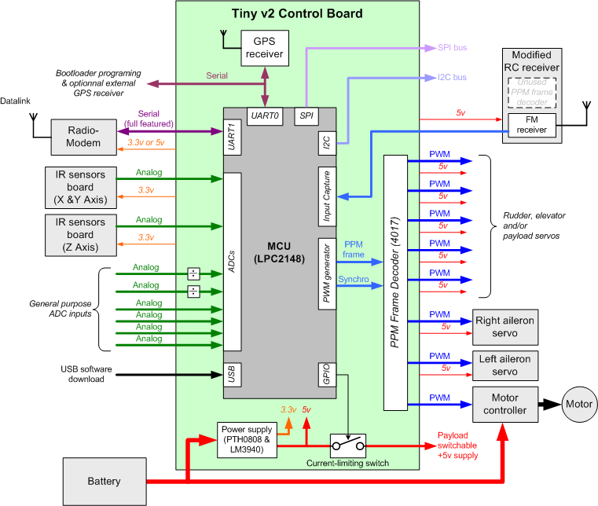
Autopilot System Concept Generation
Option 3: Paparazzi Tiny v2.11 autopilot

Slide 45
Autopilot System Concept Generation
Major Sensors: GPS and IMU
GPS – Global Positioning System
  Satellite based positioning system
IMU – Inertial Measurement Unit
  An inertial measurement unit (IMU) is a sensor that is used to measure linear acceleration and orientation (roll, pitch and yaw angles). Linear acceleration is measured with the use of a set of 3 accelerometers that are placed orthogonally to one another and the orientation is measured using a gyroscope.

Slide 46
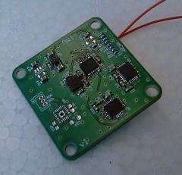
Autopilot System Concept Generation
Major Sensors: IMU
  YAI v1.0
    16 bit ADC
    200,000 samples/second
    Designed to better interface with low cost sensors

Slide 47
Imagery Concept Generation
UAS Functional Requirements:
Accurately determine target color and alphanumeric from an altitude of 500-750 ft
Transmit images or video back to the Ground-Station
120 degree or greater field of view
Pinpoint GPS locations of target locations

Slide 48
Imagery Concept Generation
Concept 1 : Still-Image Camera
Nikon D300 DSLR (Digital Single-Lens Reflex) Camera
  Advantages:
  10.2-Megapixel High Resolution (up to 3872 x 2592)
  11-point Autofocus
  Far less transmission data than a video feed
  Dedicated battery
  Disadvantages:
  Heavy and not easily mounted to the Airframe
  Image Acquisition takes longer
  Design will require a gimbal system

Slide 49
Imagery Concept Generation
Concept 2: CCD Color Video Camera
Sony KX -181 HQ Camera
Power Requirements: 12v ± 10 % DC, 100 mA
Lens type: 3.6 mm mini lens
Advantages:
  Small size (26g) is easily mounted to Airframe (25 x 25 mm)
  Designed for wireless transmissions (S/N ratio: more than 46 dB)
  Cost Effective
Disadvantages:
  No zoom feature
  Requires a gimbal design
  Horizontal Resolution is limited to 520 TV line

Slide 50
Imagery Concept Generation
Concept 3: CCD Block Camera
Sony FCB – IX11A Miniature Color Block Camera
  Used in practice by traffic monitors and police vehicles
Advantages:
  10x optical zoom feature
  Compact and lightweight design (95 g)
  High speed serial interface (up to 38.4 Kb/s)
  On screen display (date/time/title)
  Real time image acquisition
  Disadvantages:
  Requires gimbal design
  Larger power requirements (6 to 12V DC/1.6 W inactive motors 2.1 W active motors
  Must have a clean signal for target recognition

Slide 51
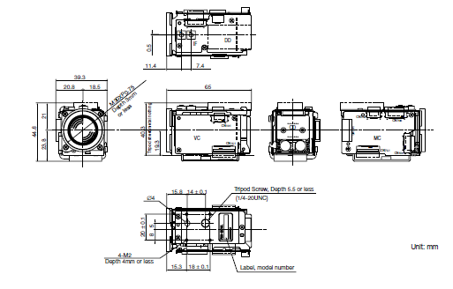
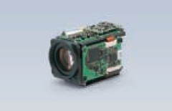
Sony FCB – IX11A Block Camera

Slide 52
Imagery Concept Generation
Concept 4: Pan/Tilt/Zoom Network Camera
AXIS 212 PTZ Network Camera
Advantages:
  Build in gimbal designed for continuous movement (± 70° Pan, ± 52 ° Tilt) with 20 present positions
  3x optical zoom up to 30 fps
  Video and Audio streaming capability
  Robust vandal-resistant casing
  Disadvantages:
  Requires dedicated power (4.9 – 5.1 V DC max 3.6 W)
  Must also transmit audio unless redesigned
  Resolution capped at 640 x 480

Slide 53
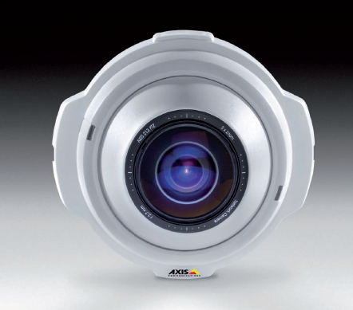
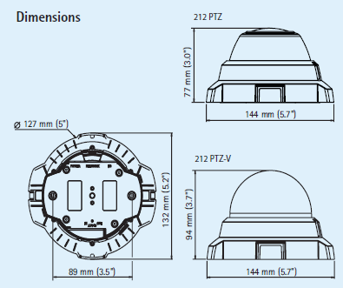
AXIS 212 PTZ Network Camera

Slide 54
Data Link Goals
Communicating with the Ground-Station
Distance from Home: 2-3 miles (3.2 km to 4.8 km)
Autopilot Data (airspeed, GPS, flight data parameters)
Transmission of Video/Image Data (real-time!)
  Use PUBLIC Frequency Bands
  Provide Electromagnetic Shielding from On-board circuits
  Separate frequencies to avoid Interference!

Slide 55
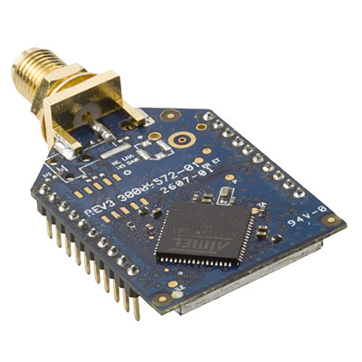
Autopilot Data Solution
  XBEE-Pro XSC
    Operating frequency 900 MHz
    Range: 370m – 24km (up to 6 miles)
    RF Data Rate: 9.6 Kbps
    Power requirement: 100 mW

Slide 56
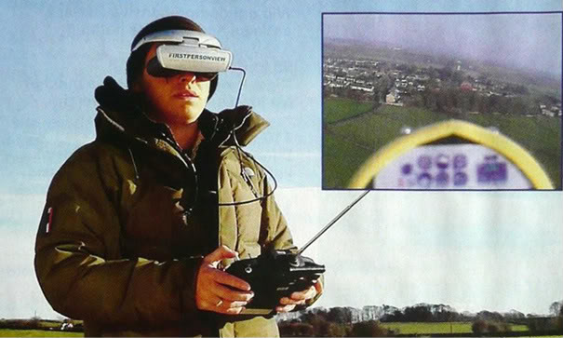
Camera Data Link
Modified FPV (First Person View) System

Slide 57
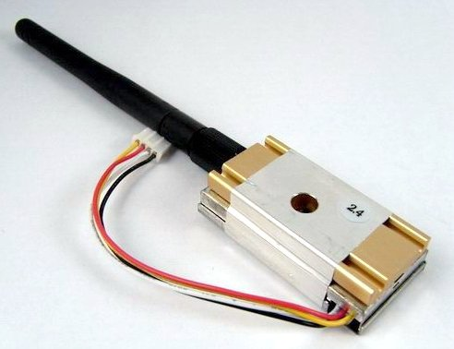
Camera Data Link
LawMate Wireless Tx
Operational Frequency: 2.4 GHz
Power: 1000 mW
Real time data acquisition

Slide 58



Post Image Acquisition
What will happen to images/video on the ground?
  GeoTagging the image (synced with telemetry data, GPS)
  Image Processing Tools: MATLAB, LabView, OpenCV
  Store data

Slide 59
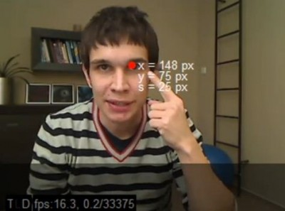
Image Recognition
Concept:
  Modify or design custom algorithms to identify targets on the ground
  Teach our system to learn all letters, colors, shapes, and orientation
  Design a cross-validation system
    Improves accuracy
    Lower number of false positives

Slide 60
ANY QUESTIONS?

Slide 61
References
http://en.wikipedia.org/wiki/Unmanned_Aircraft_System#UAS
http://code.google.com/p/ardupilot-mega/wiki/RC
http://paparazzi.enac.fr/wiki/Tiny_v2
http://paparazzi.enac.fr/wiki/GPS
http://www.cloudcaptech.com/piccolo_sl.shtm
http://www.sparkfun.com/products/9436
http://www.u-blox.com/images/downloads/Product_Docs/LEA-6_DataSheet_%28GPS.G6-HW-09004%29.pdf
http://paparazzi.enac.fr/wiki/Inertial_Measurement_Units
http://en.wikipedia.org/wiki/Lithium-ion_polymer_battery
http://en.wikipedia.org/wiki/Nickel%E2%80%93cadmium_battery
http://en.wikipedia.org/wiki/Nickel%E2%80%93metal_hydride_battery
http://rcvehicles.about.com/od/basics/ss/electricnitro_3.htm
http://electronics.howstuffworks.com/motor5.htm
http://www.themarinedoctor.com/Propellers.htm
http://www.wix.com/hobbyland/radiotowertoys/page-6
http://en.wikipedia.org/wiki/Brushless_DC_electric_motor

Slide 62
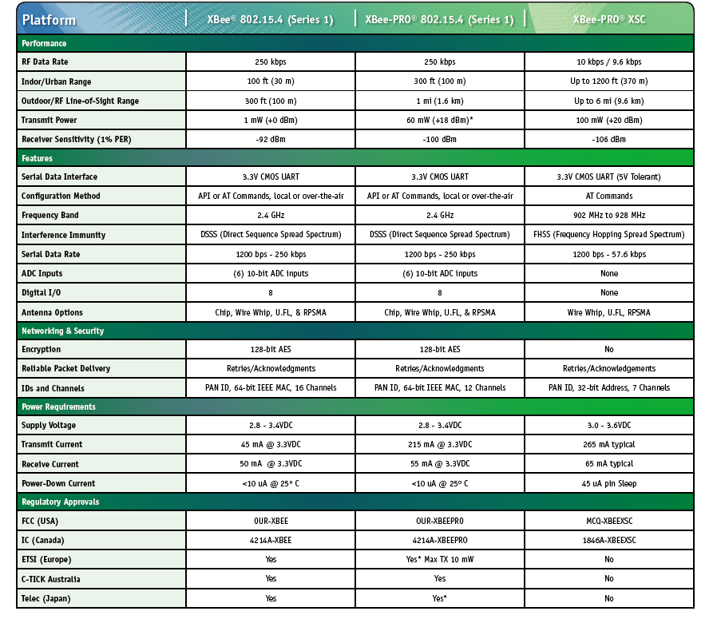

Slide 63
